Slide 1
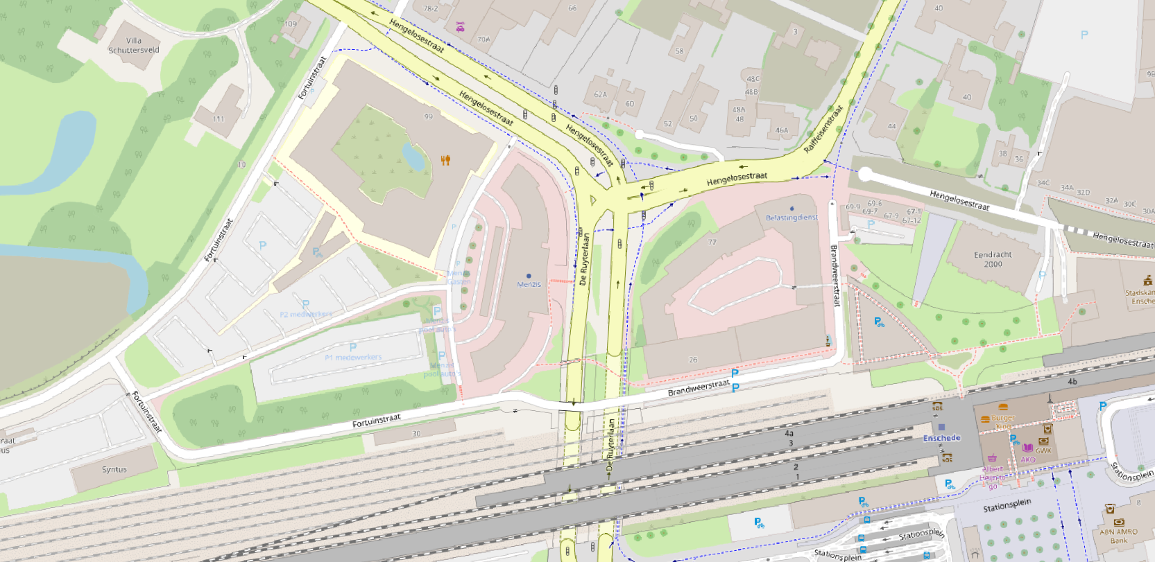
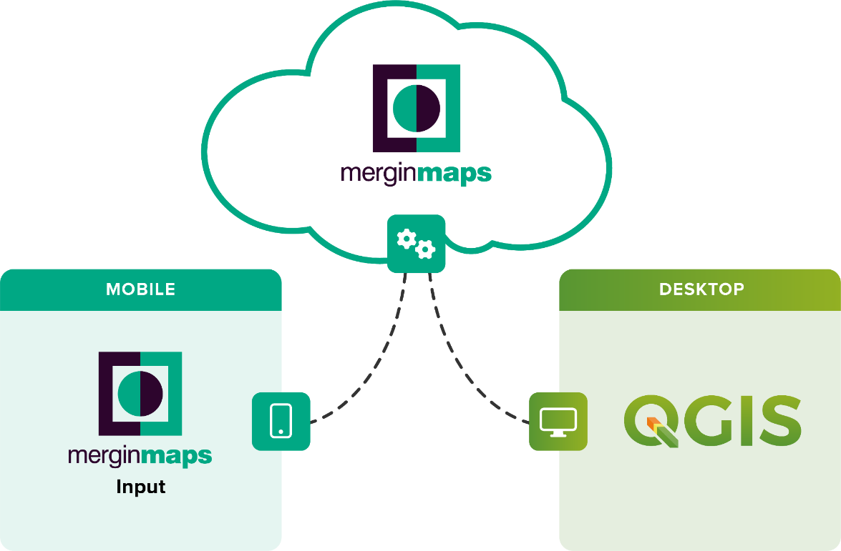
Field data Collection with QGIS and Mergin Maps
Kurt Menke & Saber Razmjooei
Septima P/S & Lutra Consulting
Notes:
Welcome to the course!

Slide 2


Saber Razmjooei
Lutra Consulting
Founder & CEO
Msc in Water Resource Engineering
Worked in the UK water sector for 10 years
saber.razmjooei@lutraconsulting.co.uk

Slide 3


Kurt Menke
Copenhagen, Denmark
Do a mix of spatial analysis, cartography & teaching
QGIS user since 2005 (v 0.7)
QGIS teacher since 2009 (v1.0)
OsGeo Charter Member
Notes:
I am in Denmark, working from home today. I work for Septima, a small Danish open-source company with about 30 employees. Mostly developers.

Slide 4
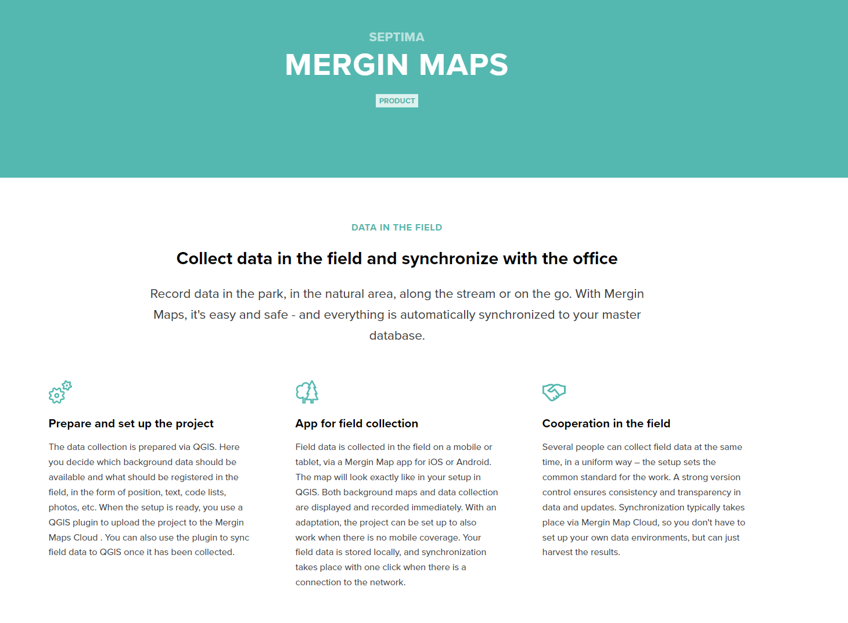
Mergin Maps Partners
https://septima.dk/showcases/mergin-map

Slide 5
Today’s Agenda
13:30 Intro & Set Up
13:45 Set up QGIS Project
Basic QGIS project
Basemaps
Survey layer
(offline/online)
Project properties
Attribute form widgets
Drag n Drop Designer
QGIS Plugin for Mergin Maps
15:00 Coffee Break
15:30 Outside data collection
16:00 Sync data to QGIS
16:15 Additional resources
16:30 Question/Answer session

Slide 6


Getting Started: Software Requirements
QGIS 3.28 or above https://qgis.org/en/site/forusers/download.html
Mergin Maps account: sign up here: https://merginmaps.com/docs/setup/sign-up-to-mergin-maps/
QGIS plugin for Mergin Maps
Mergin Maps Input: you can install it on Android and Apple devices
https://play.google.com/store/apps/details?id=uk.co.lutraconsulting
https://apps.apple.com/us/app/input/id1478603559?ls=1

Slide 7
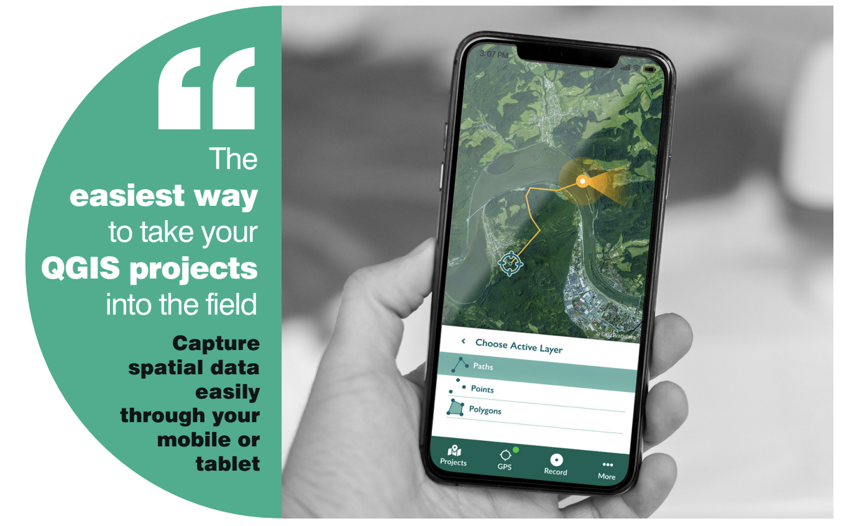





Slide 8






Slide 9

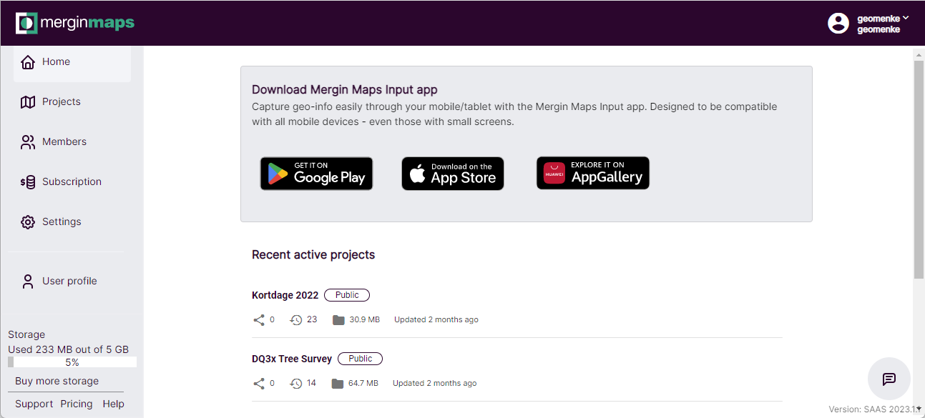
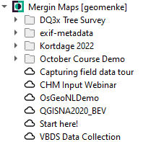

A cloud service
Stores your data
Tracks changes to your data
Manage versions
Allows you to share projects
A QGIS Plugin
Allows you to sync projects and data between QGIS and your mobile device
Toolbar
Data provider in the Browser Panel

Slide 10
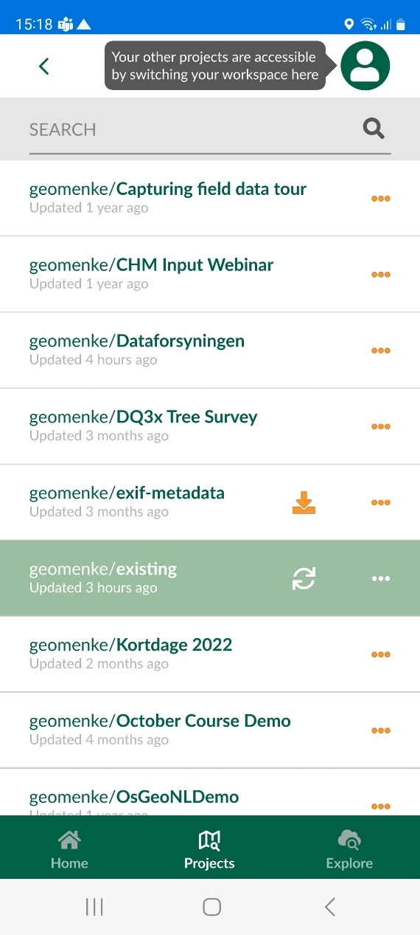
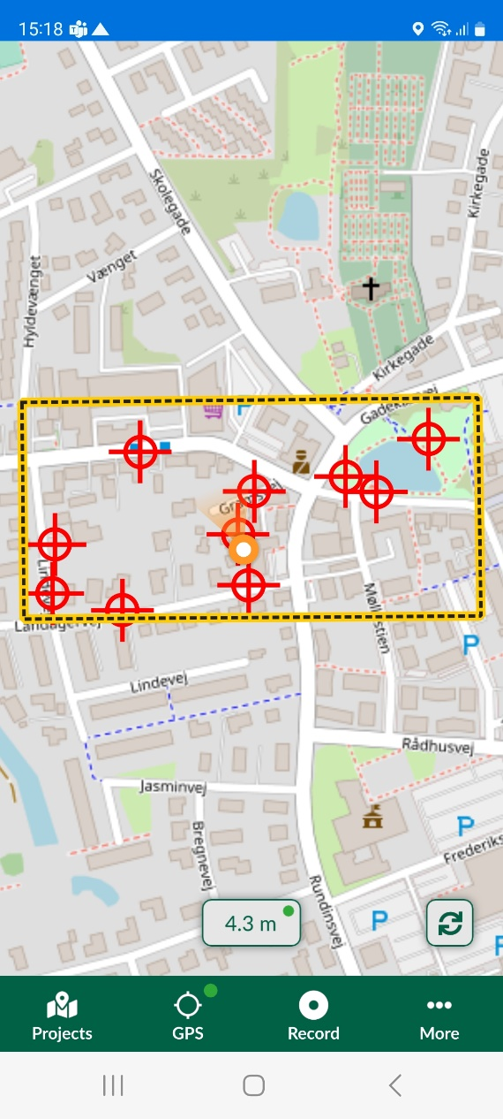
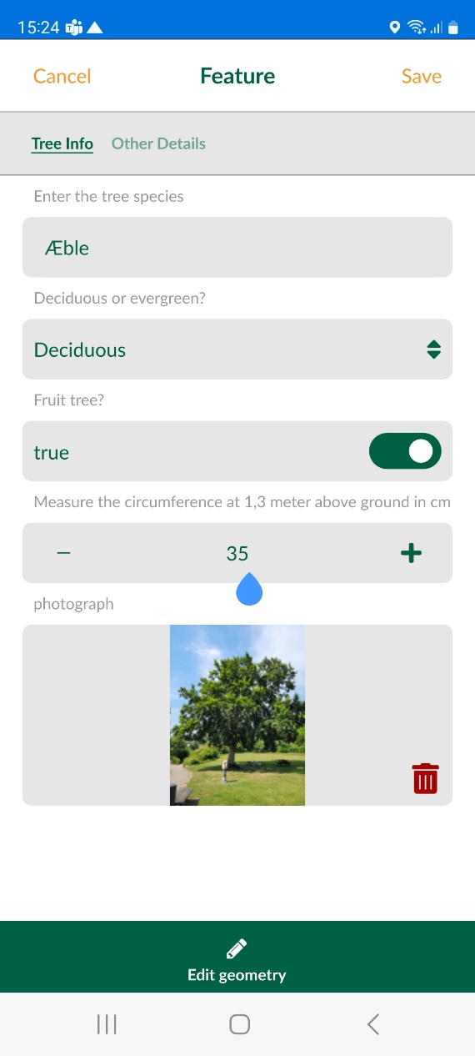
Mergin Maps Input App

Slide 11
Mergin Maps Workspaces (introduced 31.January, 2023)
A MM account has a Workspace
Each tied to a Subscription (account)
Each is a billing entity
Workspace
Replaces organizations & personal namespaces
Serves your entire team
Can contain multiple projects
Users can be invited (via email) to a workspace as a guest or member. These users do not need a Subscription
https://merginmaps.com/docs/manage/workspaces/

Slide 12
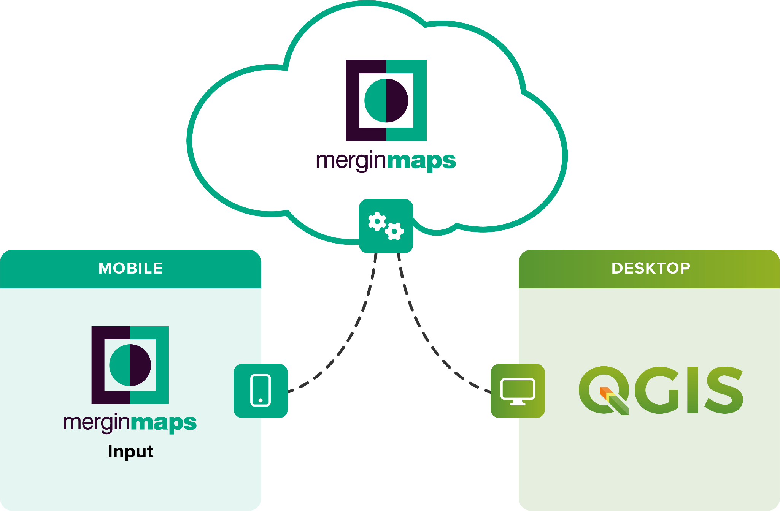
Working with QGIS & Mergin Maps
Notes:
Mergin Maps Input is a simple survey app allowing users to capture data in the field. Forms and data preparation can be done in QGIS software and synchronized with the Mergin Maps Input app using the QGIS plugin for Mergin Maps. It may sound like a lot of parts but you will see it is relatively intuitive and easy to use.

Slide 13
Basic Workflow
Preparing project:
user loads background and survey layers
set up the forms
apply styling to the layers
set up map themes and define the layers to be used for survey purposes.
Data/project transfer: once the project is set up, users need to transfer data to the device. This is achieved with the QGIS plugin for Mergin Maps.
Working with Mergin Maps Input: Collect field data and synchronizing the changes back to the Mergin Cloud.
Synchronizing the data back to QGIS: Using the QGIS plugin for Mergin Maps the data can be synchronized back to the desktop for management, analysis and cartography.
Notes:
This is the typical workflow that gives you the most flexibility.

Slide 14
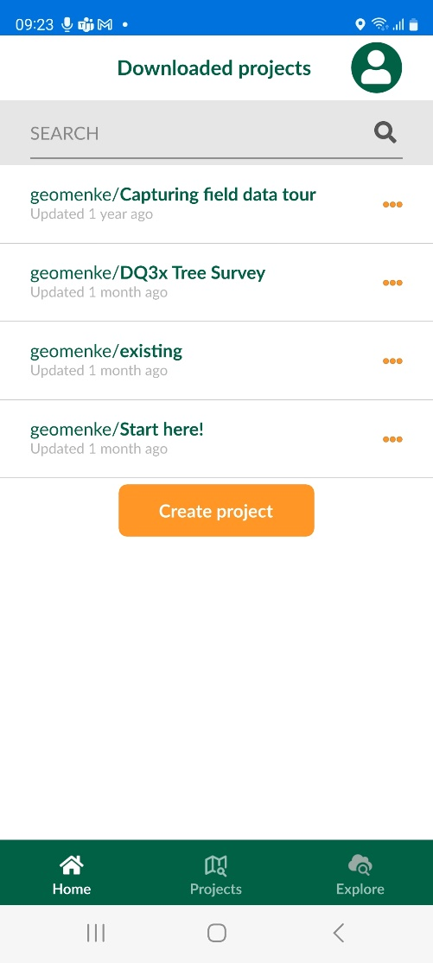
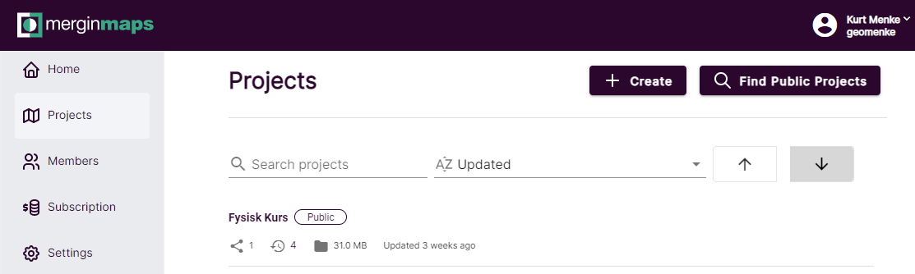
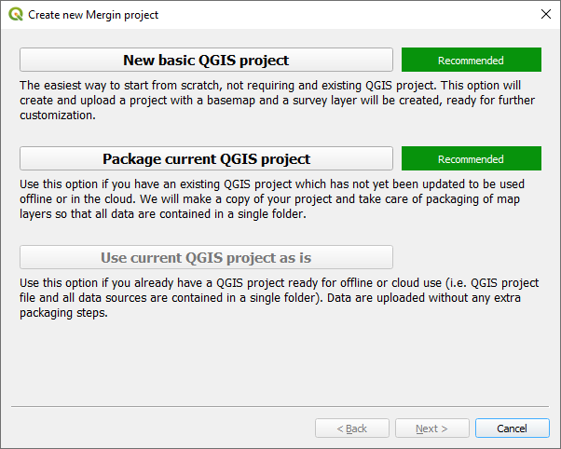
There are easier ways to set up a MM project
From Mergin Maps Input From Mergin Maps web
From QGIS

Slide 15
Getting Started Projects
Mergin Maps Input

Slide 16
Best Practices
Create a single folder for your project.
Everything must be saved to the project folder: QGIS project file & all file-based data.
Basemaps: Use XYZ Tiles services or WMS(T).
Plugins such as QuickMapServices are also good choices.
Use the Geopackage format for your data!
Use a separate Geopackages for each individual survey layer
Identify within QGIS (Project Properties), which layers are for survey, and which are for background only
Notes:
It is important that everything related to your QGIS project lies in this folder, including any project data files and the QGIS project file.
Input supports collaborative editing, if you use GeoPackage file format for your survey layer. If you use for example ESRI shapefile for your survey layer, Input is not able to detect changes from other users and overwrites them. It will keep a copy of the overwritten files with 'conf' in the name. So, in summary, always use GeoPackage for your survey layer.

Slide 17
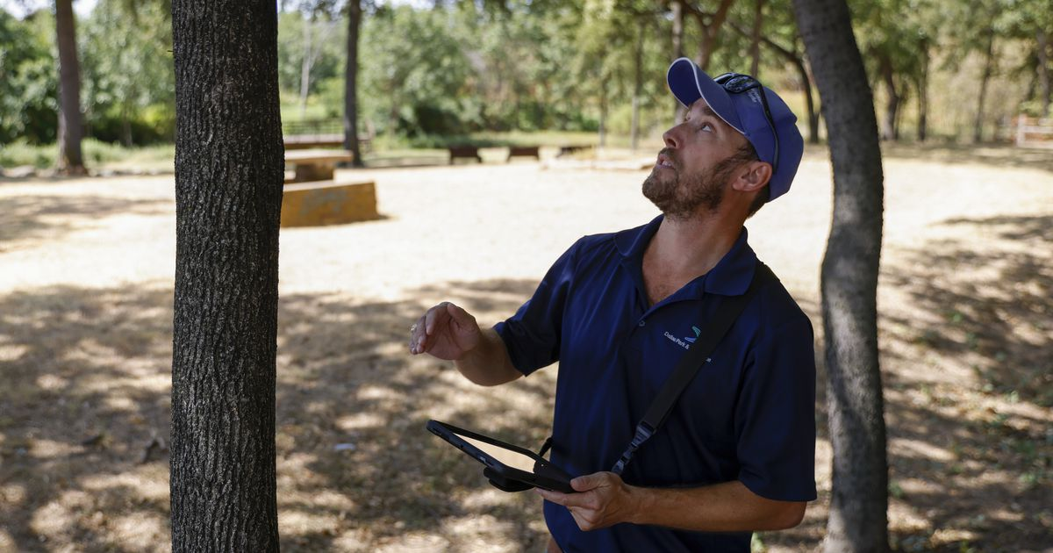
Today’s Exercise
Set up a project in QGIS to conduct a tree survey

Slide 18
Let’s Get Started
Create a folder for today’s field data collection project
This will contain everything related to your QGIS project
QGIS project file
Data

Slide 19
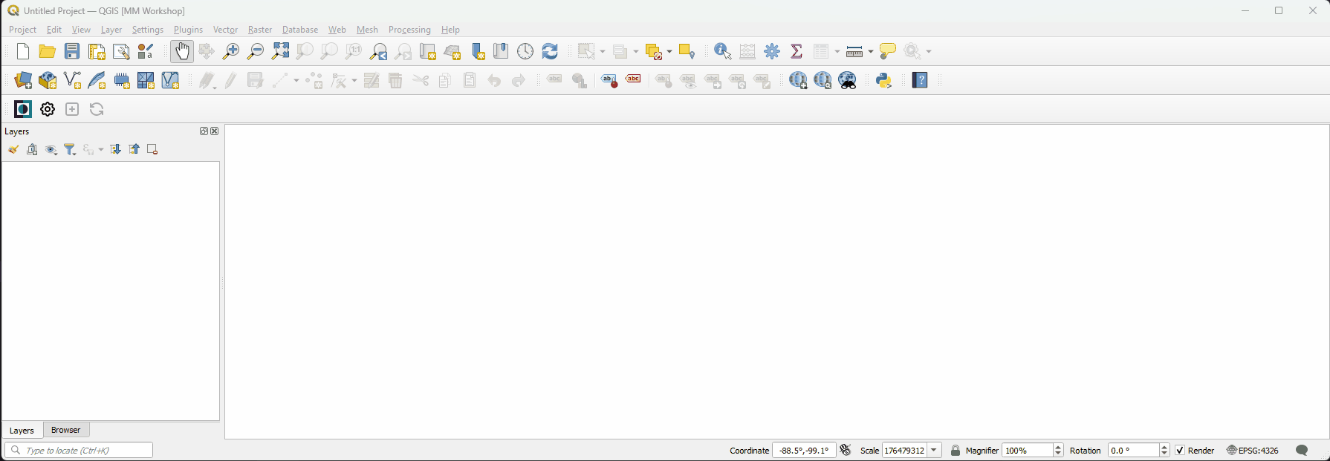
Basemaps - Loading XYZ Tile Services
Browser panel → XYZ Tiles
OpenStreetMap → Add to map canvas

Slide 20
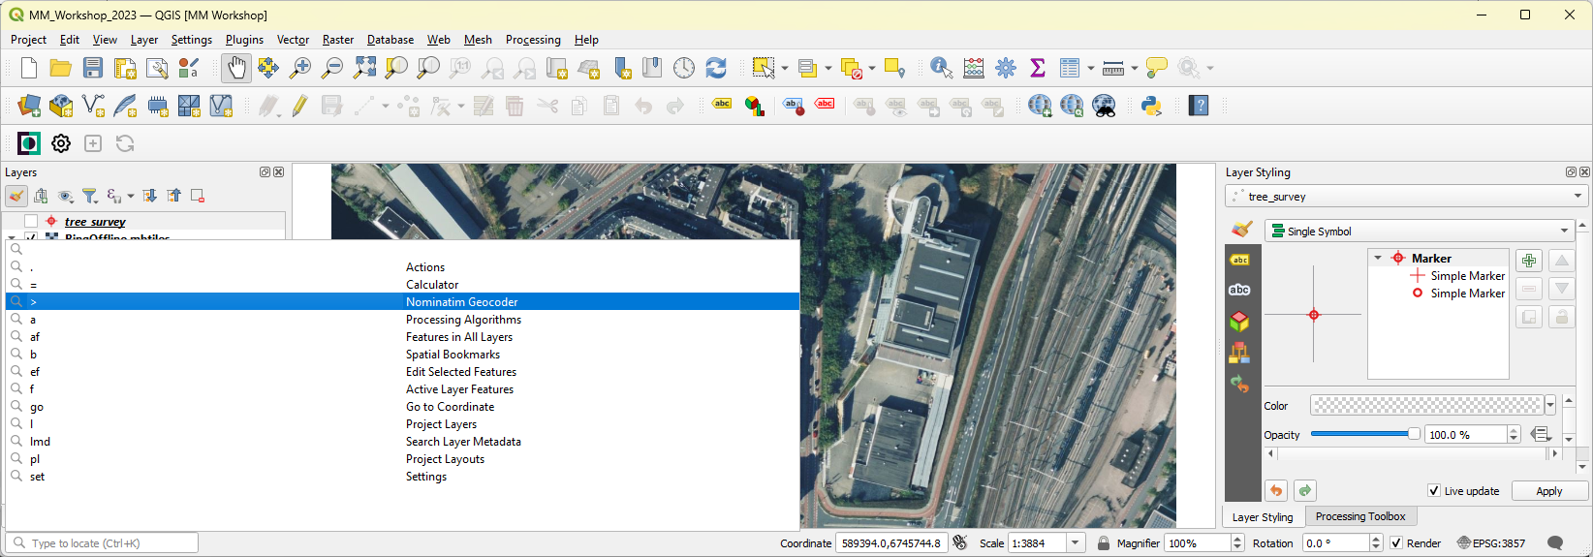
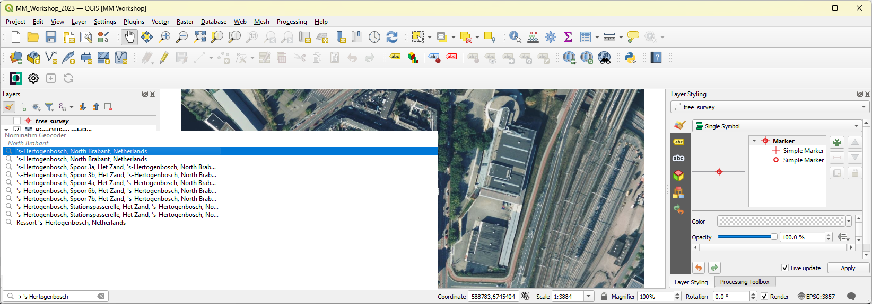
Zooming to ‘s-Hertogenbosch
2
1
3

Slide 21
Connecting to the Bing Imagery XYZ Tiles
From the Browser panel, right-click on XYZ Tiles and select New Connection …
For Name type Bing imagery
For URL type http://ecn.t3.tiles.virtualearth.net/tiles/a{q}.jpeg?g=1
Press OK

Slide 22
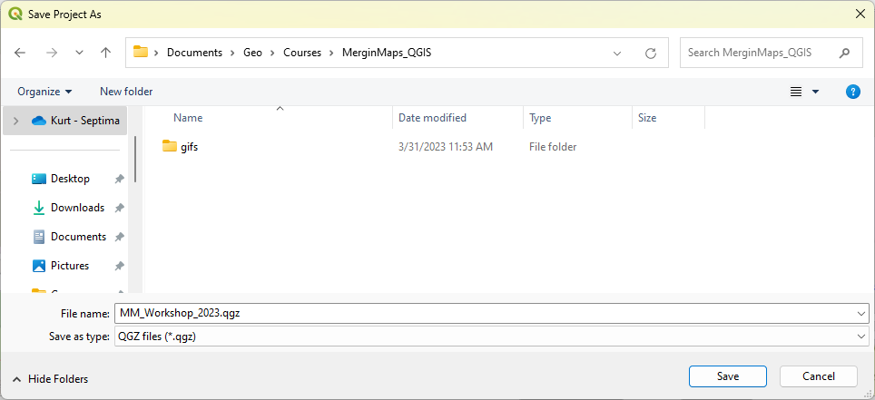
Save Project
Set Project CRS to 3857 to match the CRS of the XYZ Tile Layers
Save project into the Course folder

Slide 23
Task 1
Create a project folder
Load basemaps
Set project CRS to EPSG: 3857
Save your project into project folder

Slide 24
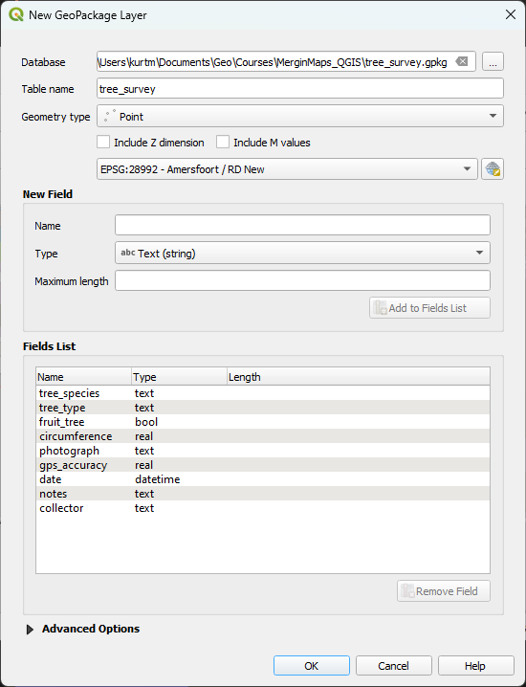
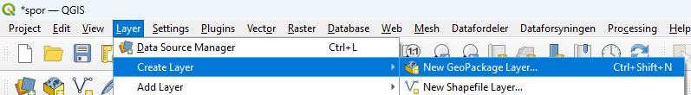
Creating the Survey Layer
1
2
3
4
Layer menu → Create Layer → Create New Geopackage Layer
Save Geopackage into your project folder
EPSG: 28992
Remember: start a new geopackage for each different survey layer!
5
6

Slide 25
Survey Layer Fields/Types
Field Name | Field Type
tree_species | text
tree_type | text
fruit_tree | boolean
circumference | decimal (real)
photograph | text
gps_accuracy | decimal
date | date & time
notes | text
collector | text

Slide 26
Task 2
Create survey layer
Add attributes
Apply styling for the survey layer

Slide 27
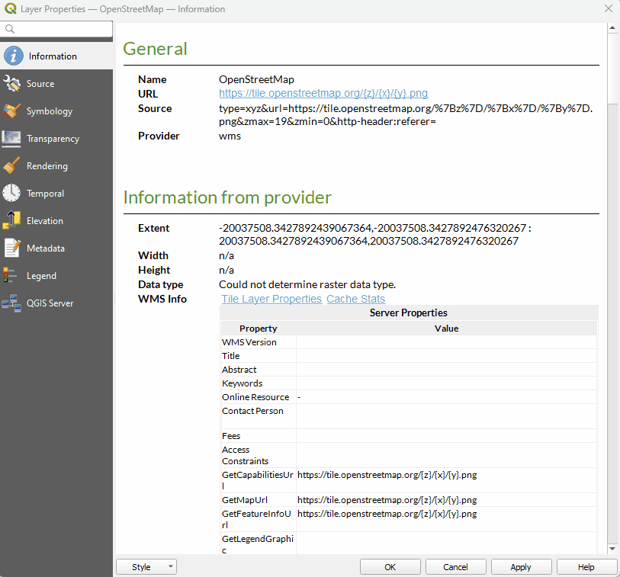
Configuring XYZ Tile Layers for MM Input
Layer Properties → Source tab
Set Tile Resolution to 256 x 256
This can help make labels more readable on mobile devices with a high-resolution display

Slide 28
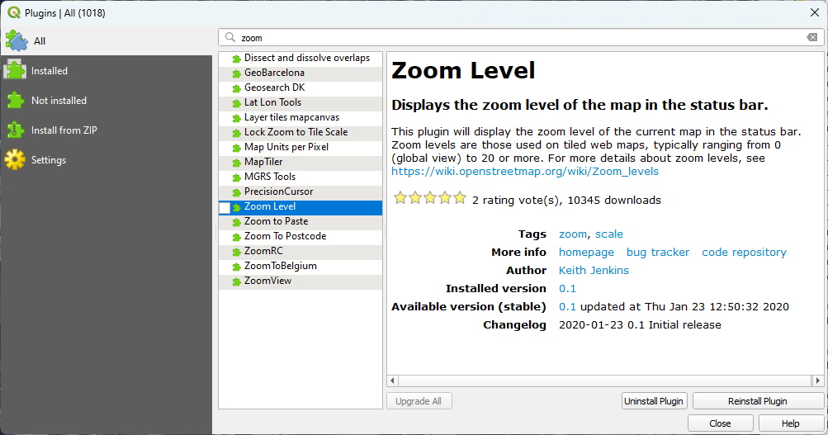
Install the Zoom Level plugin
Displays the zoom level of the current map in the Status bar of QGIS.
Zoom levels are those used by tiled map services
0 … 20

Slide 29
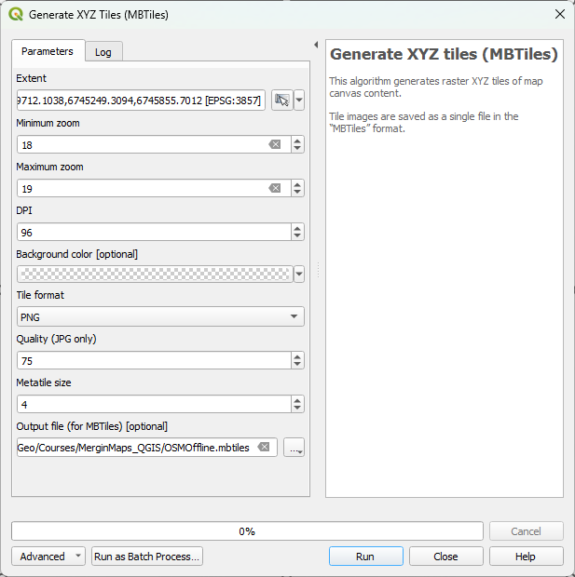
Setting Up an Offline OSM Basemap
6
7
Zoom to survey area
Turn on only the OSM layer
Open the Processing Toolbox
Search for ‘Tiles’
Open Generate XYZ Tiles (MBTiles)
Set the Extent to the Map Canvas
Set Min – Max zoom to 18 & 19
Save as OSMOffline.mbtiles
into project folder
8
9

Slide 30
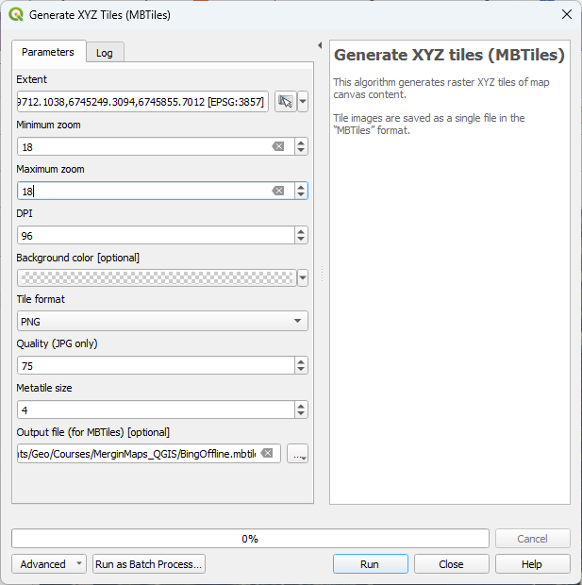
Setting Up a Offline Satellite Basemap
3
4
Turn on just the Bing Imagery layer
Open Generate XYZ Tiles (MBTiles)
Set the Extent to the Map Canvas
Set Min – Max zoom to 18 & 18
Save as SatelliteOffline.mbtiles
into project folder
5
6

Slide 31
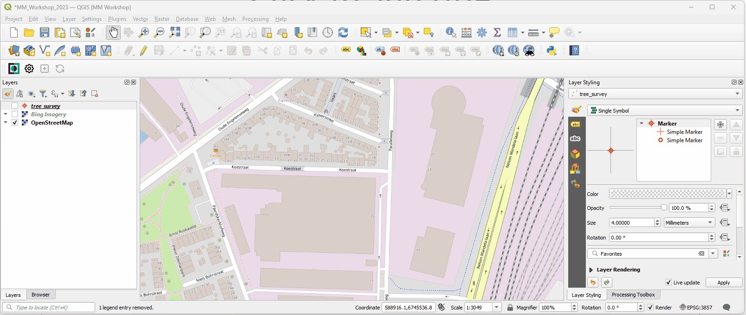
Add MBTiles Layers to QGIS

Slide 32
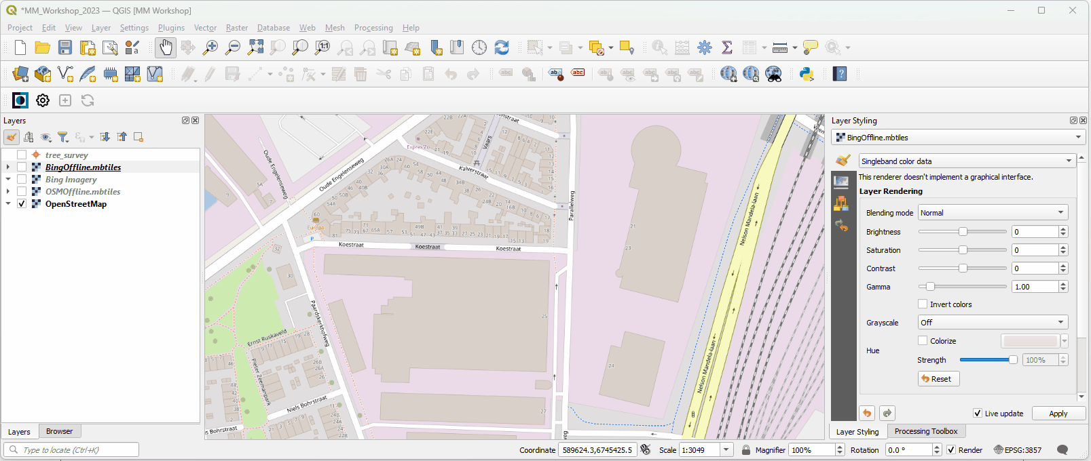
Create Map Themes

Slide 33
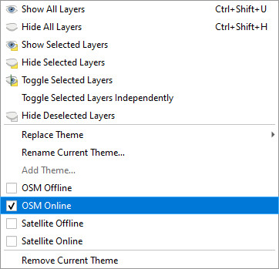
Create Map Themes
Create These Themes
OSM Offline
OSM Online
Satellite Offline
Satellite Online

Slide 34
Task 3
Install Zoom Level plugin
Generate MBTiles layers for each basemap
Create Map Themes

Slide 35
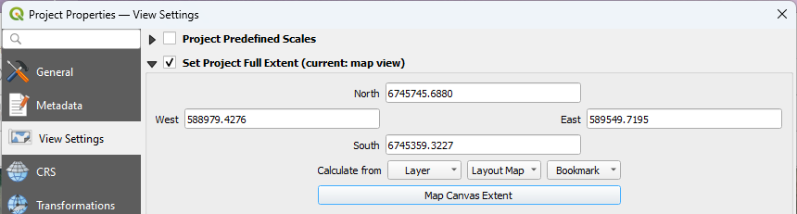
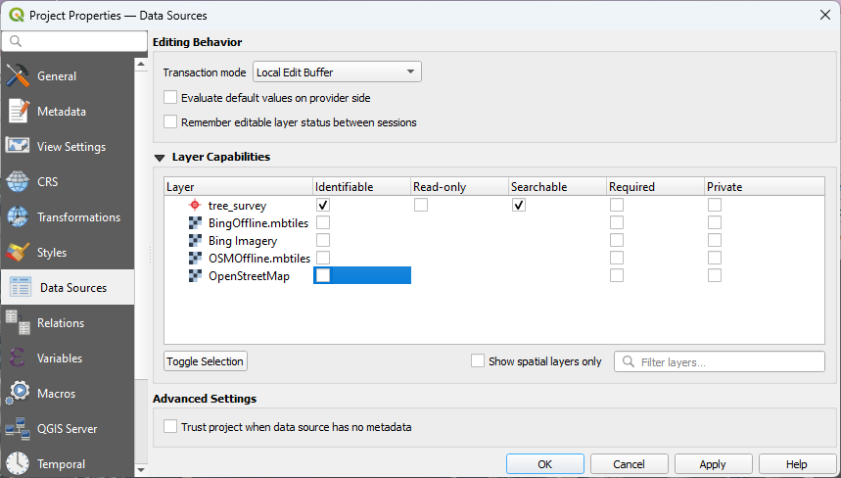
Project Level Settings
Mergin Maps Input has an option to to zoom to the project extent. If not set, Mergin Maps will zoom to all visible layers. Here you can contrain the extent to the current canvas extent.
2
1
3
Here you can disinguish between survey layers and background layers (read-only).
You can also set which layers are Searchable & Identifiable in Mergin Maps Input.
2
1

Slide 36
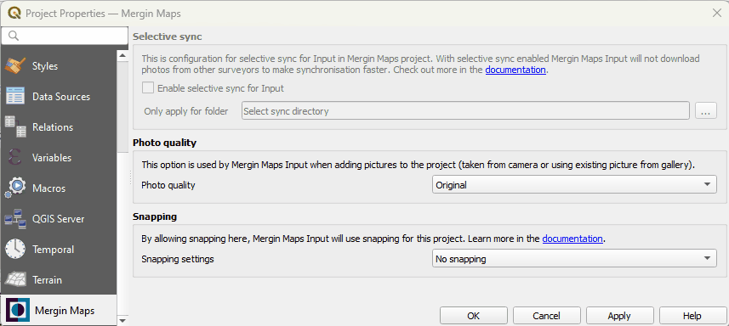
Mergin Maps Project Level Settings
1
Photo Quality setting
Snapping setting

Slide 37
Task 4
Configure Project Level Settings
Data Source settings
View settings

Slide 38
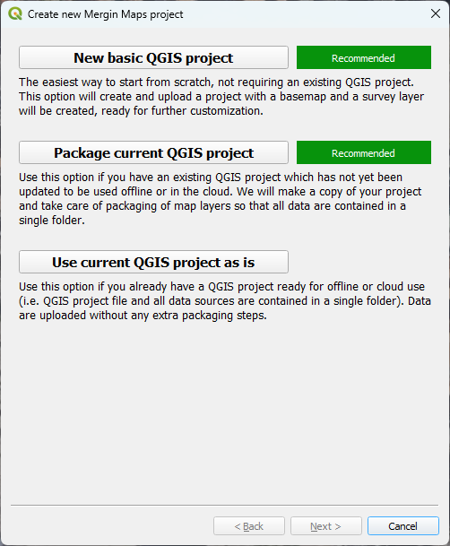

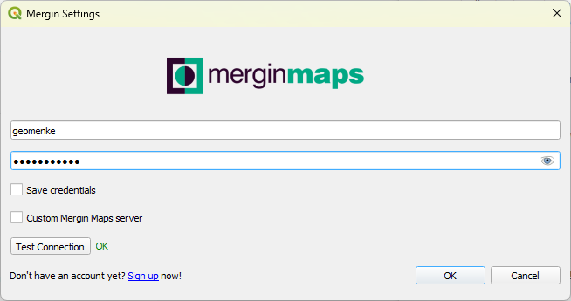
QGIS Plugin for Mergin Maps
Enter your credentials
1
5
6
2
3
4

Slide 39
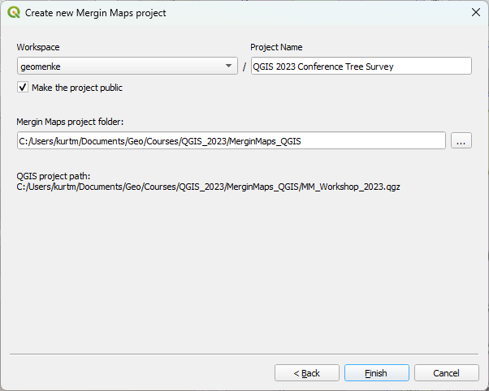
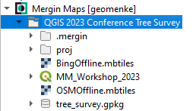
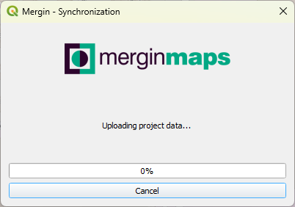
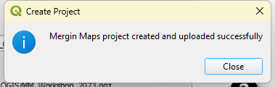
QGIS Plugin for Mergin Maps
Name your project Browser Panel
1
3
2

Slide 40
Task 5
Use the MM plugin to create a Mergin Maps Project

Slide 41
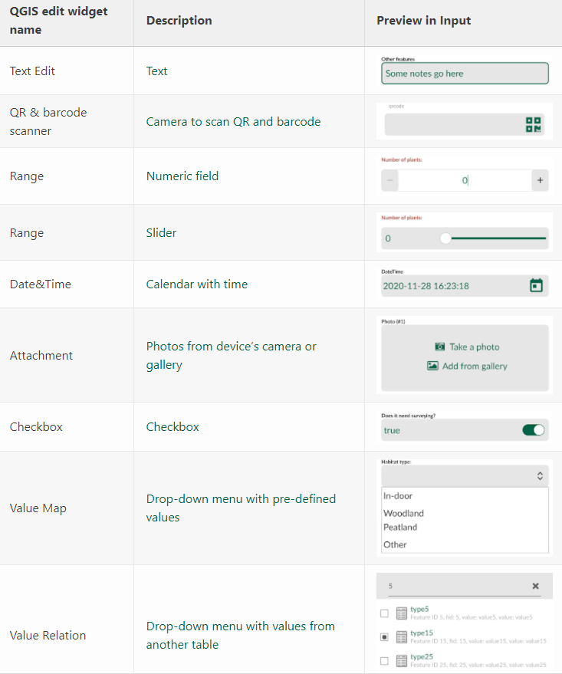
QGIS Attribute Field Widget Types
https://merginmaps.com/docs/layer/settingup_forms/

Slide 42
Optional Mergin Maps Variables
Variable name | Sample value | Scope | Description
@mergin_username | geomenke | global | Name of the user currently logged in to Mergin Maps
@mergin_url | https://app.merginmaps.com | global | URL of the Mergin Maps service
@mergin_project_name | Tree survey | project | Name of the active Mergin Maps project
@mergin_project_owner | geomenke | project | Name of the owner of the active project
@mergin_project_full_name | geomenke/Tree survey | project | Owner and project name joined with a forward slash
@mergin_project_version | 12 | project | Current version of the active project
https://merginmaps.com/docs/layer/plugin-variables/
Notes:
The @mergin_username variable was just mentioned as an option for the default value in a field such as the collector. This variable is added when the QGIS Plugin for Mergin Maps is installed. There are several additional QGIS Plugin for Mergin Maps variables you can use as default values (figure 1.17). You can read more about them here: https://merginmaps.com/docs/layer/plugin-variables/.

Slide 43
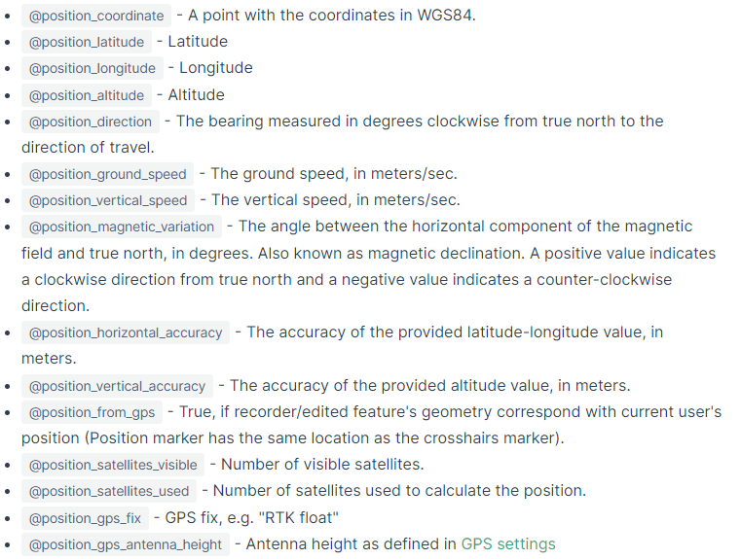
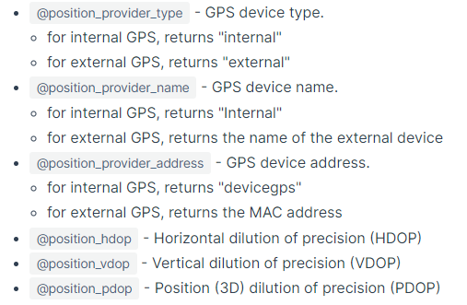
Optional MM Input Position Variables
https://merginmaps.com/docs/layer/position_variables/
Notes:
When you set up the forms you can configure default values

Slide 44
Field Widgets: Layer Properties → Attributes Form
Field | Widget type | Alias | Other Settings | More Settings
fid | Hidden | ...
tree_species | Text | ... | Option to enter a default value
tree_type | Value Map | ... | Enter Values & Descriptions | Deciduous|Evergreen
fruit_tree | Checkbox | ...
circumference | Range | ... | Editable, Slider or Dial | Min (5), Max (1000) & Step (0.5)
photograph | Attachment | ... | Store path as: Relative to project path | Integrated Document Viewer → Image
gps_accuracy | Hidden | ... | Default value: @position_horizontal_accuracy
date | Date/Time | ... | Default value: now()
notes | Text | ... | Option to check Multiline
collector | Text edit | ... | Default value: @mergin_username

Slide 45
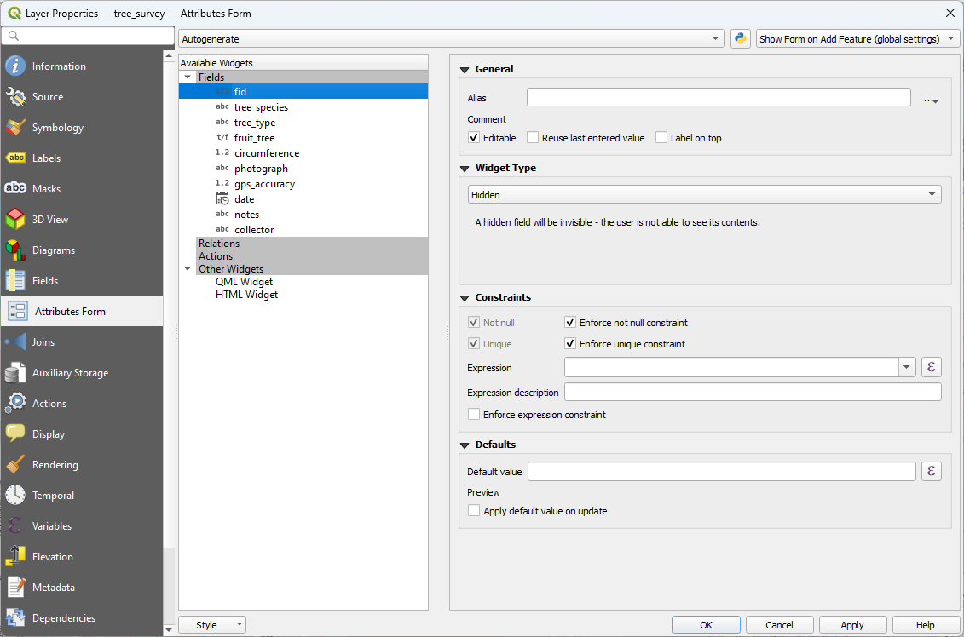
fid

Slide 46
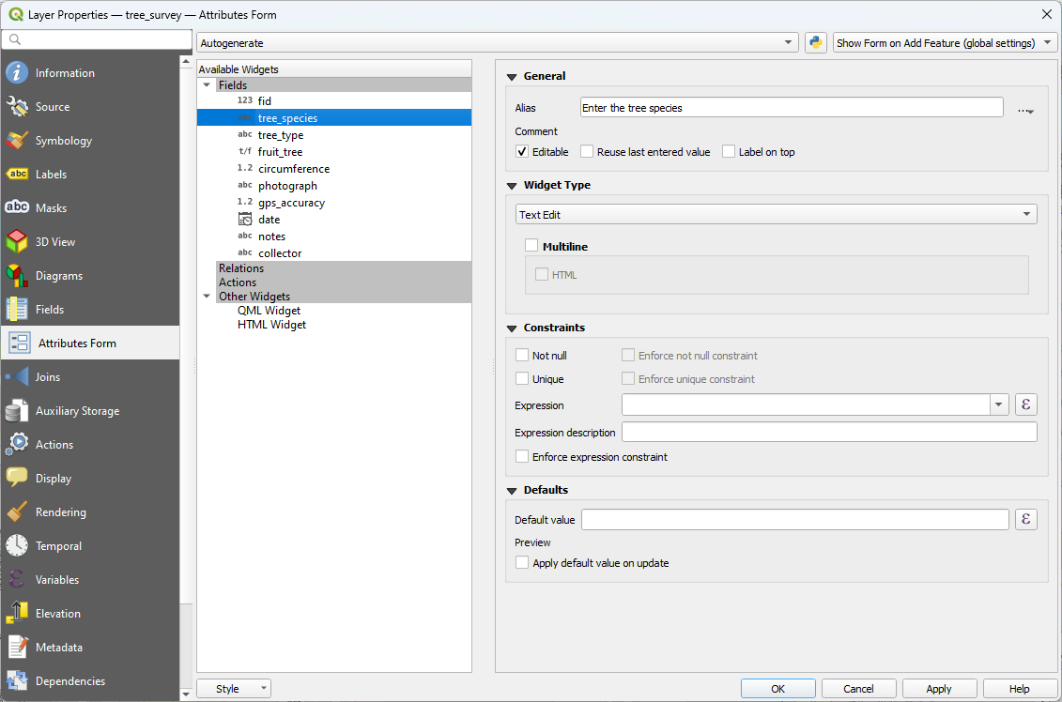
tree_species

Slide 47
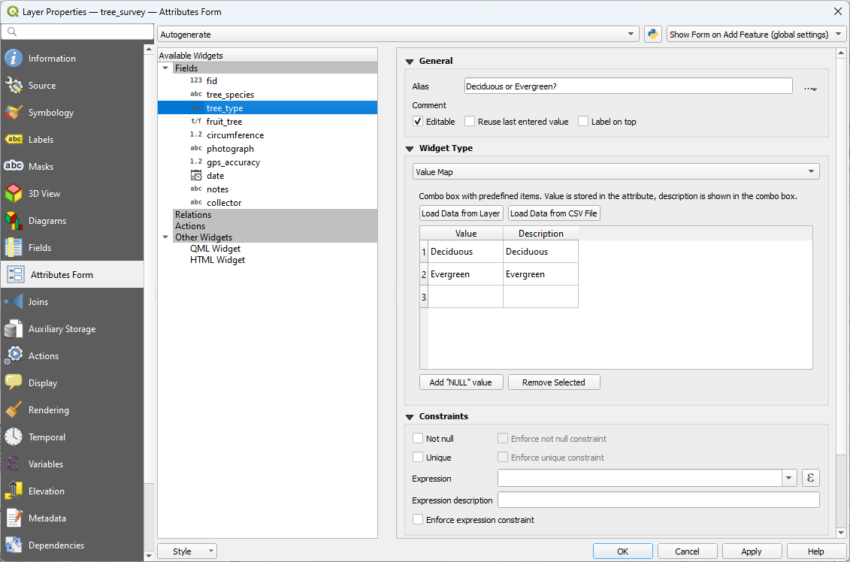
tree_type

Slide 48
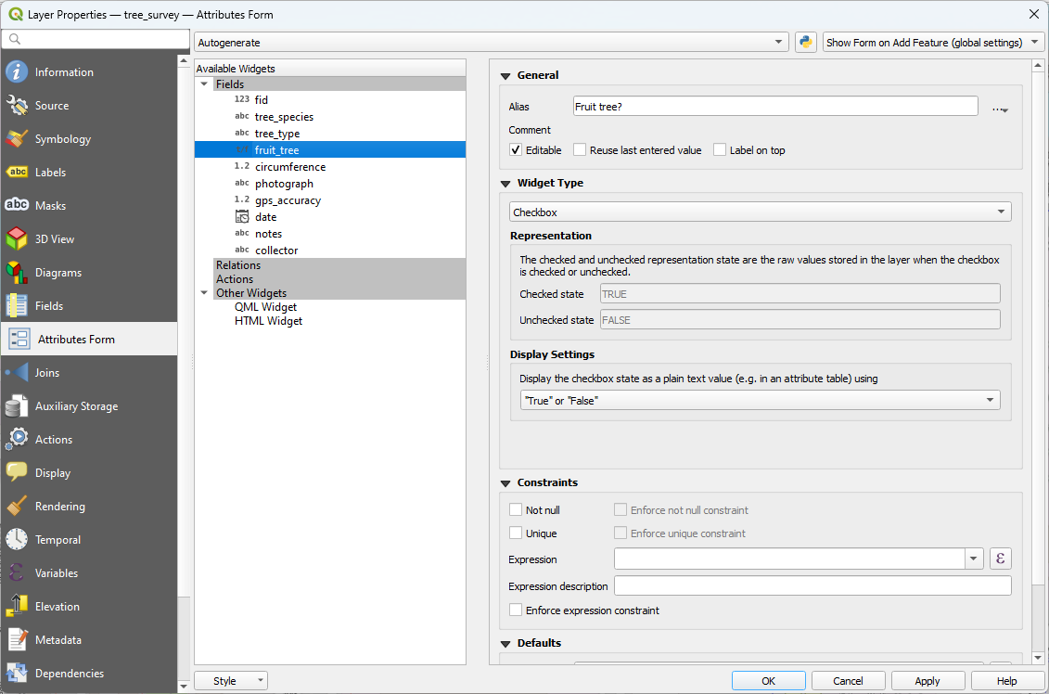
fruit_tree

Slide 49
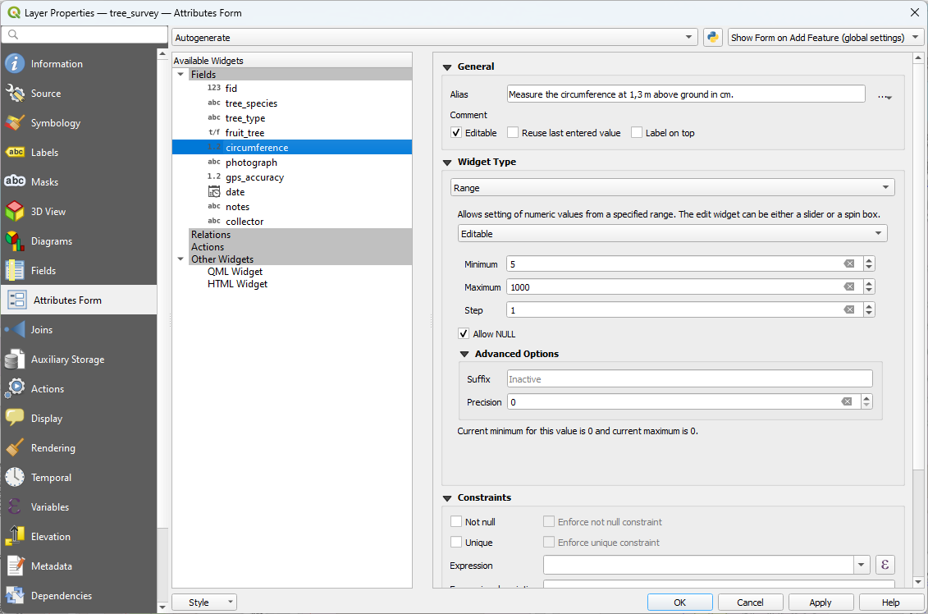
circumference

Slide 50
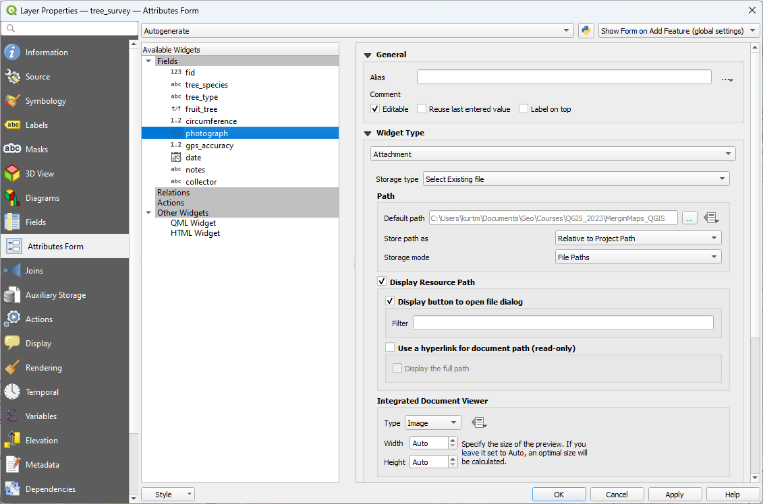
photograph

Slide 51
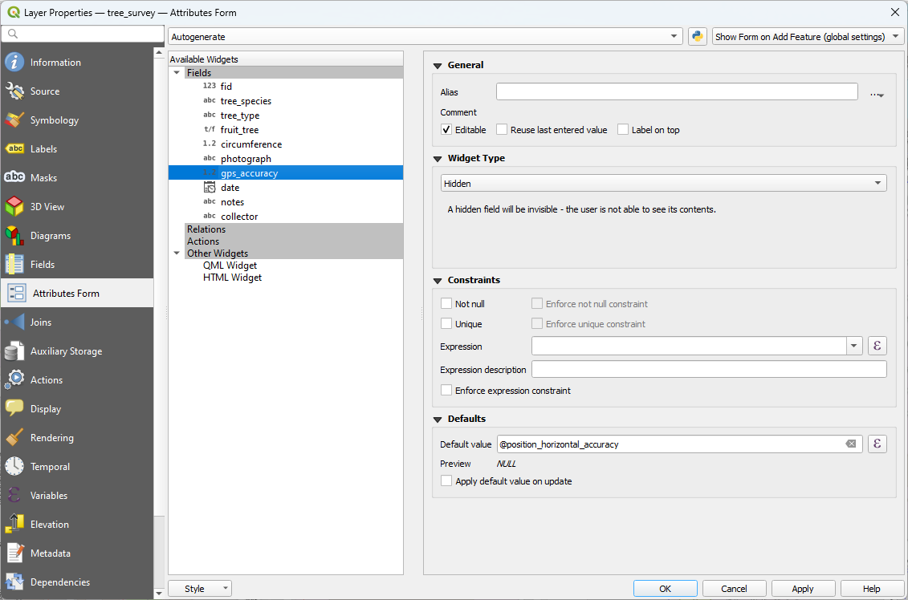
gps_accuracy

Slide 52
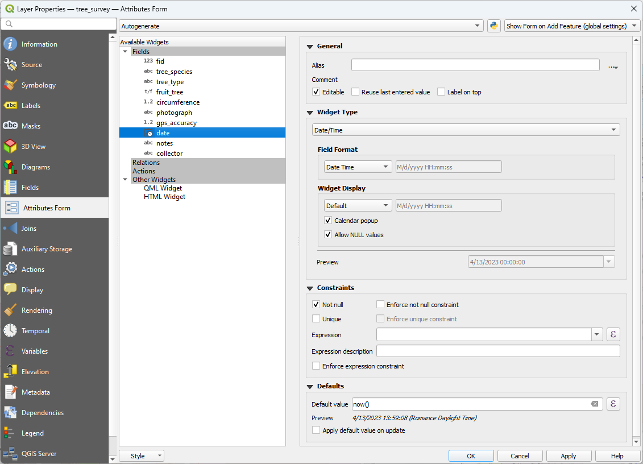
date

Slide 53
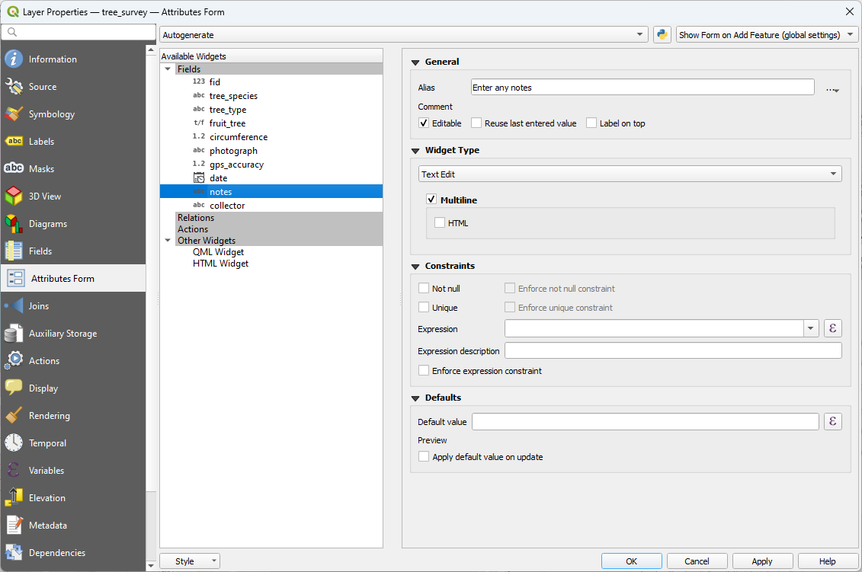
notes

Slide 54
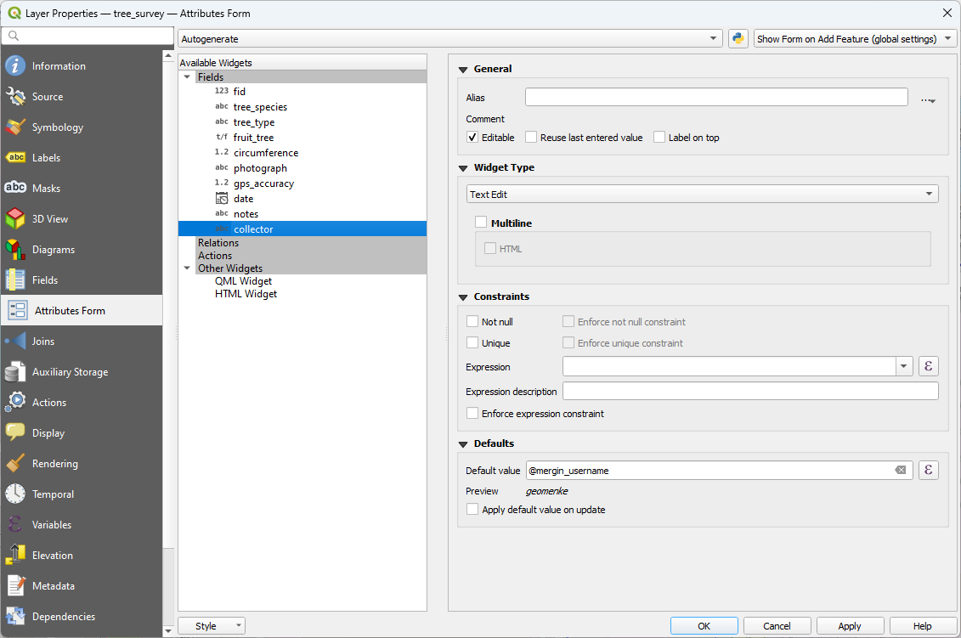
collector

Slide 55
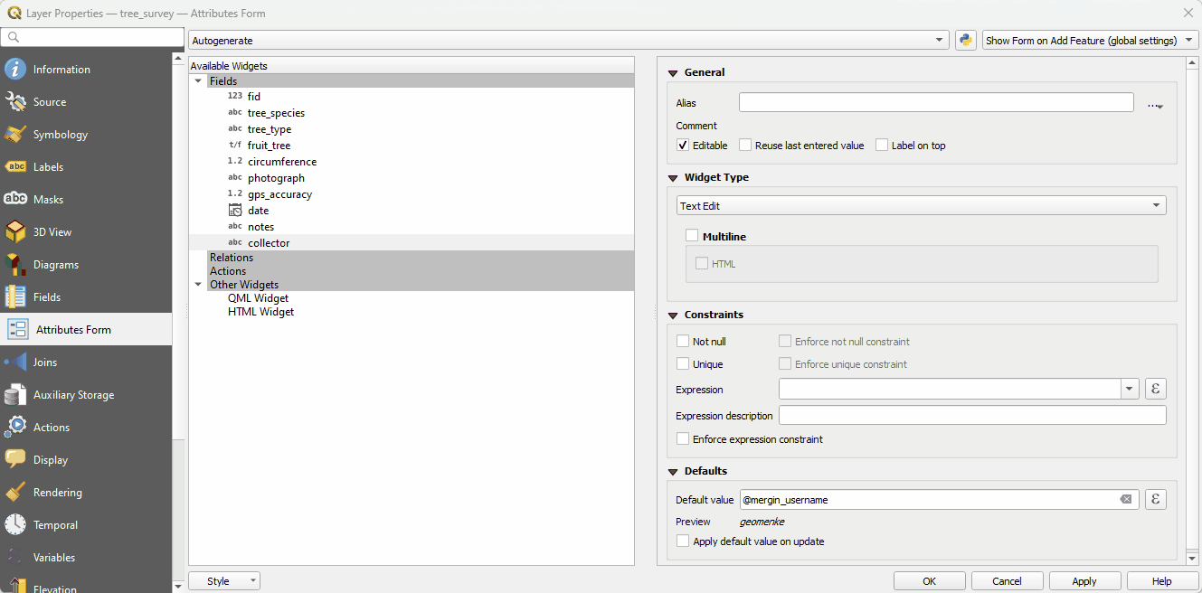
QGIS Drag and Drop Designer

Slide 56
Task 6
Configure Field Widgets
Configure via Drag and Drop Designer

Slide 57

Update Project
Save your QGIS project

Slide 58
Task 7
Collect some data!

Slide 59

Mergin Maps Online
Mergin Maps Input

Slide 60
Task 8
Sync Data Back to QGIS

Slide 61


Slide 62

Additional Resources
Mergin Maps Online Documentation
https://merginmaps.com/docs/

Slide 63

Lutra Consulting News
https://www.lutraconsulting.co.uk/blog/

Slide 64

Input/Mergin Slack Channel
https://merginmaps.com/community/join/

Slide 65


OPEN
Part 3- Data Acquisition & Management
Exercise 1 : Field Data Collection w/Mergin Maps
https://locatepress.com/book/dq32
https://store.locatepress.com/
Notes:
It has five parts, each is essentially a university course.

Slide 66


Podcast Episode
https://mapscaping.com/podcast/qgis-offline-and-in-the-field/
Episode 166
8 August, 2022

Slide 67

Pricing

Slide 68


Thanks!
Kurt Menke
https://septima.dk/
Copenhagen, Denmark
kurt@septima.dk
@GeoMenke
Saber Razmjooei
https://www.lutraconsulting.co.uk/
London, UK
saber.razmjooei@lutraconsulting.co.uk
@lutraconsulting

Slide 69


Changing Mergin Maps Workspaces
https://merginmaps.com/docs/manage/workspaces/

Slide 70

Mergin Maps Changes Viewer

Slide 71





Mergin Maps Tools in QGIS

Slide 72


Scanning QR Codes
Peter Petrik
October 4, 2022
Do you know that you can scan QR codes directly with #MerginMaps in the field?
We implemented it in May 2021.
In #QGIS, the field name or the field alias has to contain the word "qrcode" and the scanner will be automatically shown in the app.

